Slide 1
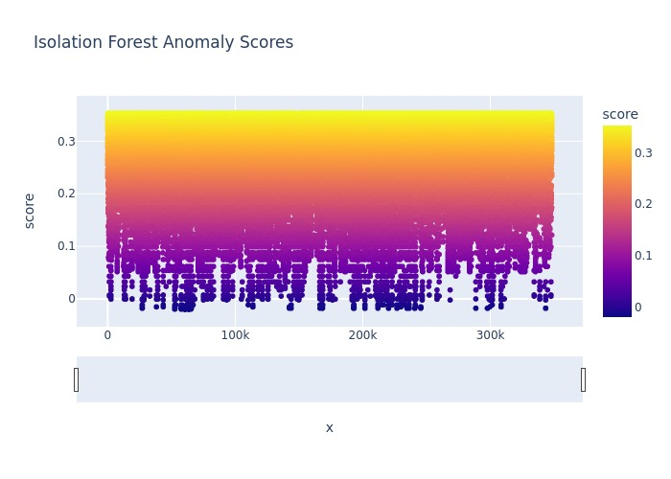
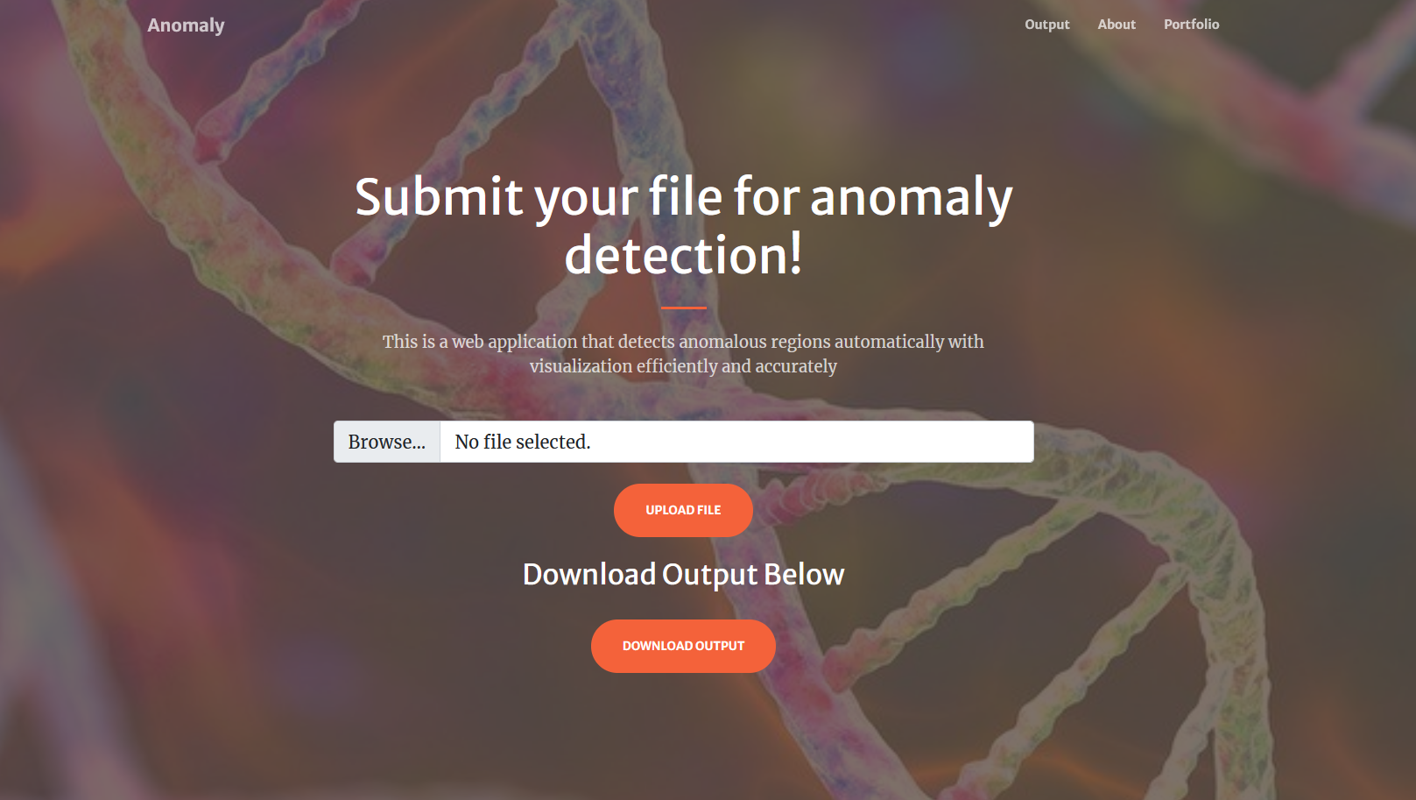
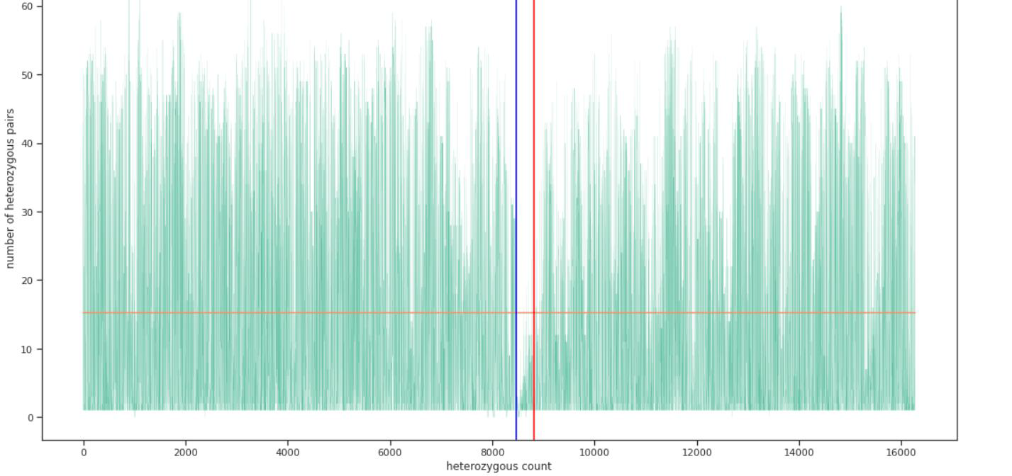
Project Title
#1
Materials & Implementation Process
Department of Electrical Engineering and Computer Science ”
As this is a software project, no materials were necessary. The core of the code is written using various Python libraries, such as numpy, scipy, scikit-allel, seaborn, and pandas. Additionally, the end-user interface was built with the LAMP stack.
Team Members
Faculty Advisor
John Callaghan Oasis Husband Avigail Martinez Michael Hollinger
Kamal Shrouder
Prof. Hanqi Zhuang
Image Here
Image Here
Problem Statement
Community Impact
Applications such as human genomic analysis can prove troublesome on account of the huge amounts of data that must be parsed through. Because of this, there are very few readily available solutions to assist biologists in the process of genome analysis, ergo, it is virtually impossible to achieve without the benefits of machine learning algorithms.
Anomalies in human genomic data could be indicative of many things. For one, they could show the process of mutation beginning in a given population. Mutations can range anywhere from unimportant to extremely impactful. Either way, a biologist who is studying the genomic data of a large number of individuals must be aware of any possible mutations.
Image Here
Overview
Concluding Remarks
This project is a piece of software capable of analyzing a human genome and identifying any and all anomalies native to said genome using data science. Using various anomaly detection algorithms, such as Isolation Forest and SVL, the software will work to detect any and all genetic anomalies using the aforementioned Python packages. This particular project will utilize a file format known as VCF (variant call format), which in turn will denote the genome itself. The code itself will be executable via various mediums, the most prominent of which is the web app, which will allow the user to upload a VCF file to be analyzed. Upon analysis, the code will return various figures rendered using numpy and scipy depicting numerous parameters, such as kurtosis, skewness, range, mean and variance among heterozygous pairs.
The project was in fact a success. Using its robust web application, this piece of software can successfully detect anomalies in any VCF file as well as return various performance statistics from its respective dataset, such as mean, variance, skewness, and kurtosis.
Image Here
Sponsored by: Dr. Michael DeGiorgio

